Slide 1

Urban Cart E-Commerce Data Analysis Report
SQL • Pandas • NumPy • Business Insights
Lecturer: Min Sothearith |
Group:
Nak July
Dim Mengleang
Srin Chhayanuth
Tha Rotanak

Slide 2
Presentation Overview
01
02
03
Business Context & Strategic Questions
Data Sources & Quality Challenges
Methodology & Cleaning
SQL extraction, Pandas integration, and systematic data cleaning
Who is Urban Cart and what decisions does the data need to support?
Where data comes from and what imperfections needed to be addressed
04
05
NumPy Analytics
Findings & Recommendations
RFM segmentation, recommendations, regression, and simulation
Key business insights and actionable next steps

Slide 3
1. Business Context
The Retailer
Urban Cart is a fictional online retailer serving 15 cities across six product categories
Six Categories
Electronics, Home & Kitchen, Apparel, Sports & Outdoors, Beauty & Health, Books & Media
Data Sources
Customers, orders, products, reviews, and web sessions
Strategic Goal
Transform imperfect operational data into evidence for management decisions

Slide 4


Strategic Questions
Customer Value
Who are the most valuable customers, and what patterns indicate loyalty or churn?
Product Profitability
Which products and categories remain economically attractive after costs, discounts, and returns?
Demand Forecasting
Can near-term demand and stockout risk be estimated reliably?
Data Trustworthiness
Is the marketing and signup data reliable enough for management decisions?

Slide 5
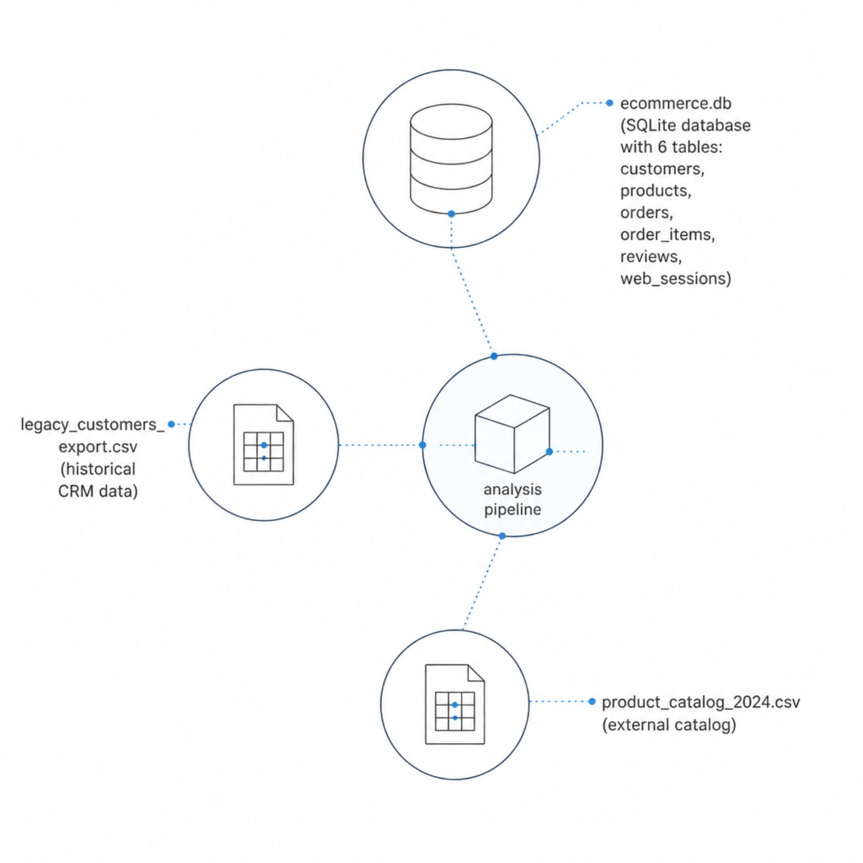
2. Data Sources & Structure
ecommerce.db
legacy_customers
_export.csv
Main transactional SQLite database — customers, products, orders, order_items, reviews, web_sessions
Historical CRM / customer export for cross-referencing and reconciliation
product_catalog_2024.csv
External product catalog used to validate
and enrich internal product records

Slide 6
Data Quality Challenges
~3%
~6%
Missing Customer Cities
Missing Customer Ages
Geographic gaps requiring imputation or exclusion from location-based analysis
Demographic gaps affecting segmentation accuracy
~20%
~5%
Missing Review Text
Duplicate Customer Records
Substantial gap in qualitative sentiment data
Near-duplicate and exact-duplicate records requiring deduplication before analysis

Slide 7

Analytical Pipeline
SQL Extract
Pandas Clean
NumPy Model
Business Action
Each stage feeds the next — raw relational data is extracted via SQL, cleaned and integrated using Pandas, quantitatively modelled with NumPy, and finally translated into evidence-based management actions.

Slide 8

3. Data Cleaning & Integration
Standardize Date Formats
Normalize multiple date formats while preserving original raw values
Detect Duplicates
Identify exact and near-duplicate customer records for deduplication
Handle Missing Values
Treat gaps according to their business meaning — not a one-size-fits-all rule
Investigate Outliers
Examine extreme prices and quantities before deciding to correct or exclude
Catalog Reconciliation
Align internal products with the external 2024 catalog and validate joins & revenue totals

Slide 9





4. NumPy Analytical Methods
RFM Segmentation
Interaction Matrix
Cosine Similarity
Score customers on Recency, Frequency, and Monetary value to identify high-value and at-risk segments
Build a customer-product interaction matrix to encode purchase behaviour at scale
Measure product similarity to generate data-driven purchase recommendations
Normal-Equation Regression
Monte Carlo Simulation
Run ≥5,000 trials to estimate stockout probability under uncertain demand conditions
Fit a regression model for a two-month revenue planning baseline

Slide 10
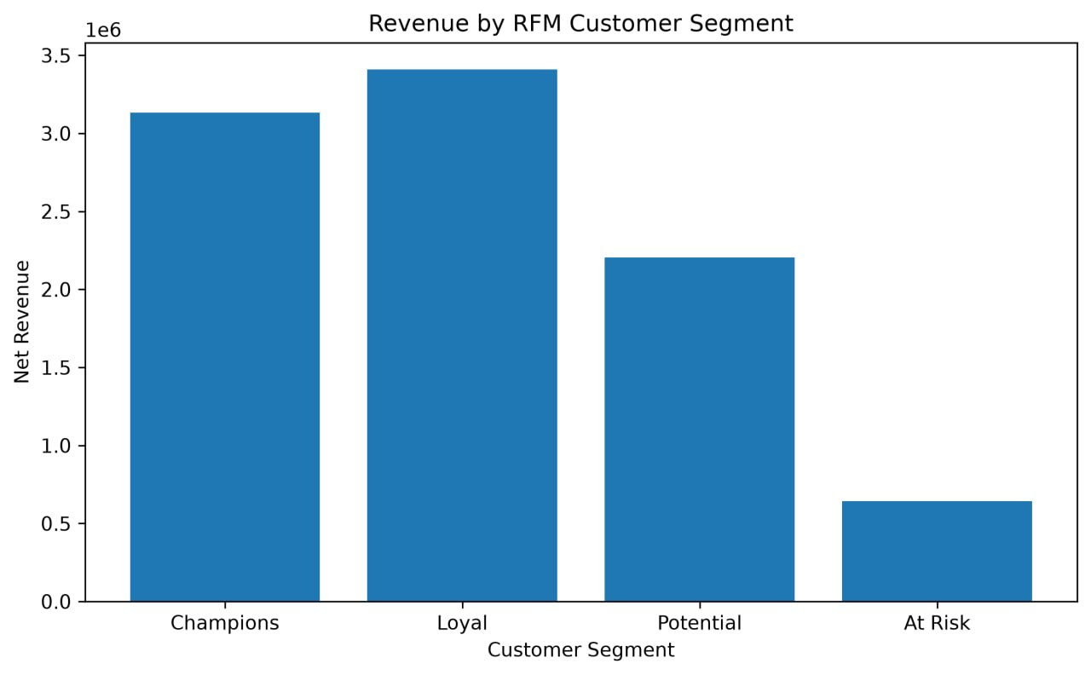
5. Key Findings

Slide 11
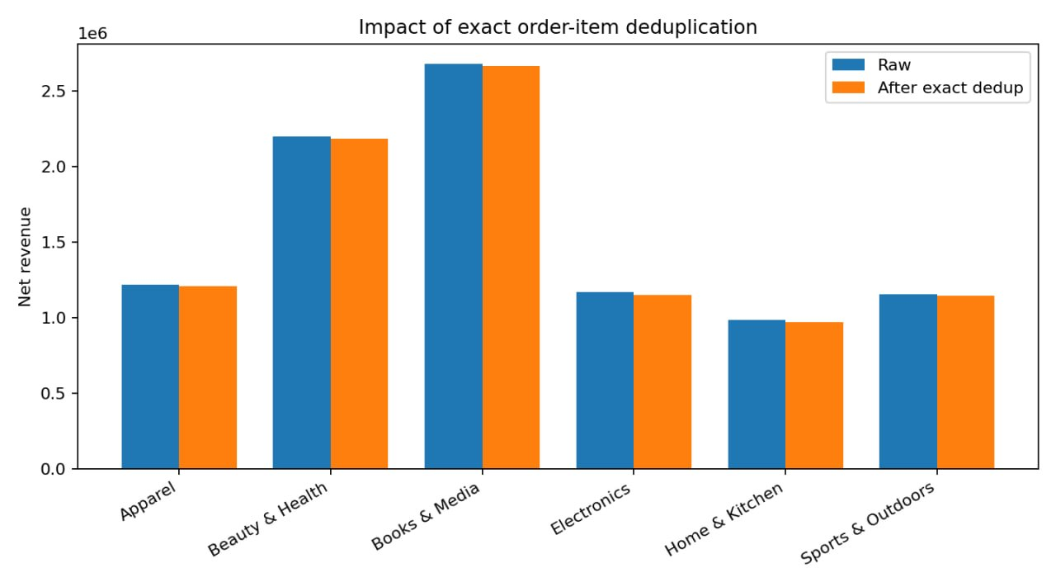
Forecasting & Inventory Risk

Slide 12
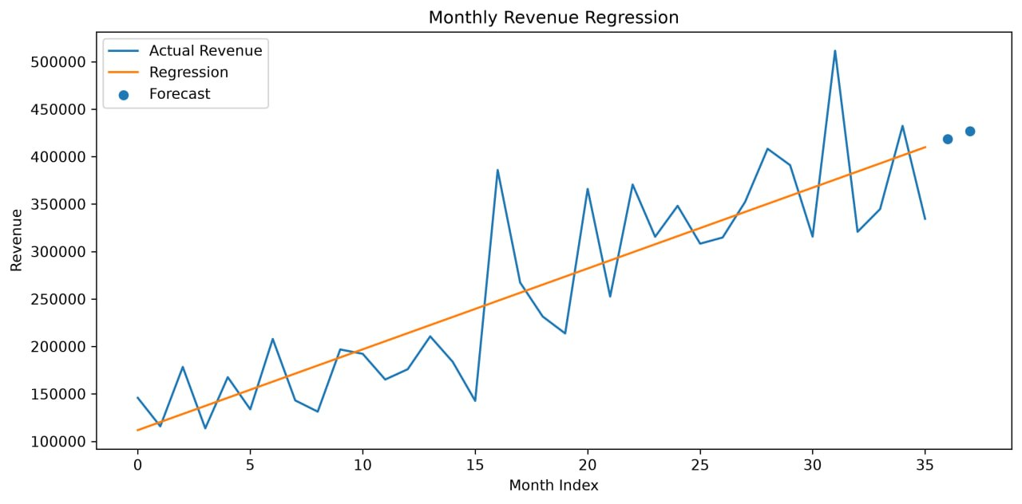
Forecasting & Inventory Risk

Slide 13





Recommendations
Customer Retention
Inventory Optimization
Margin Improvement
Protect Champions and Loyal customers; launch targeted reactivation for At Risk segments.
Prioritize high-risk products with strategic importance before scaling stock decisions.
Analyze cost, discounting, and return behavior together for a unified profitability view.
Data Governance
Digital Conversion
Monitor duplicates, missing values, and dates; reconcile identifiers across all sources.
Test device and country friction rigorously before scaling any causal claims.

Slide 14
Limitations
Segmentation Gaps
Missing demographic data may limit customer segmentation accuracy.
Duplicate Records
Near-duplicate entries may require manual review and deduplication before analysis.
Returns Treatment
Returns require explicit handling in all revenue and margin calculations.
Outlier Sensitivity
Outliers can disproportionately skew results and downstream forecasts.
Modeling Assumptions
Forecast and Monte Carlo results depend heavily on underlying modeling assumptions.

Slide 15
Conclusion
Methods & Data Quality
Connected Workflow
Urban Cart's analytical framework connects customer value, profitability, forecasting, inventory, digital conversion, and governance into a single coherent system.
Reliable analytics requires both strong methods and disciplined data preparation working in concert.
Defensible Decisions
The strongest management value comes from turning imperfect records into defensible decisions that drive measurable outcomes.

Slide 16
Thank You
Questions & Discussion
We welcome your questions, feedback, and continued collaboration on Urban Cart's commerce analytics journey.

